Slide 1
Locality-Centric Data and Threadblock Management for Massive GPUs
Mahmoud Khairy, Vadim Nikiforov, David Nellans, Timothy G. Rogers
MICRO 2020 – 9/21/2020
MICRO 2020 – 9/19/2020
Notes:
Hello everyone, My name is Mahmoud, and today I am going to present our work “Locality-Centric Data and Threadblock Management for Massive GPUs”. This work is done in collaboration between Purdue University and Nvidia.

Slide 2
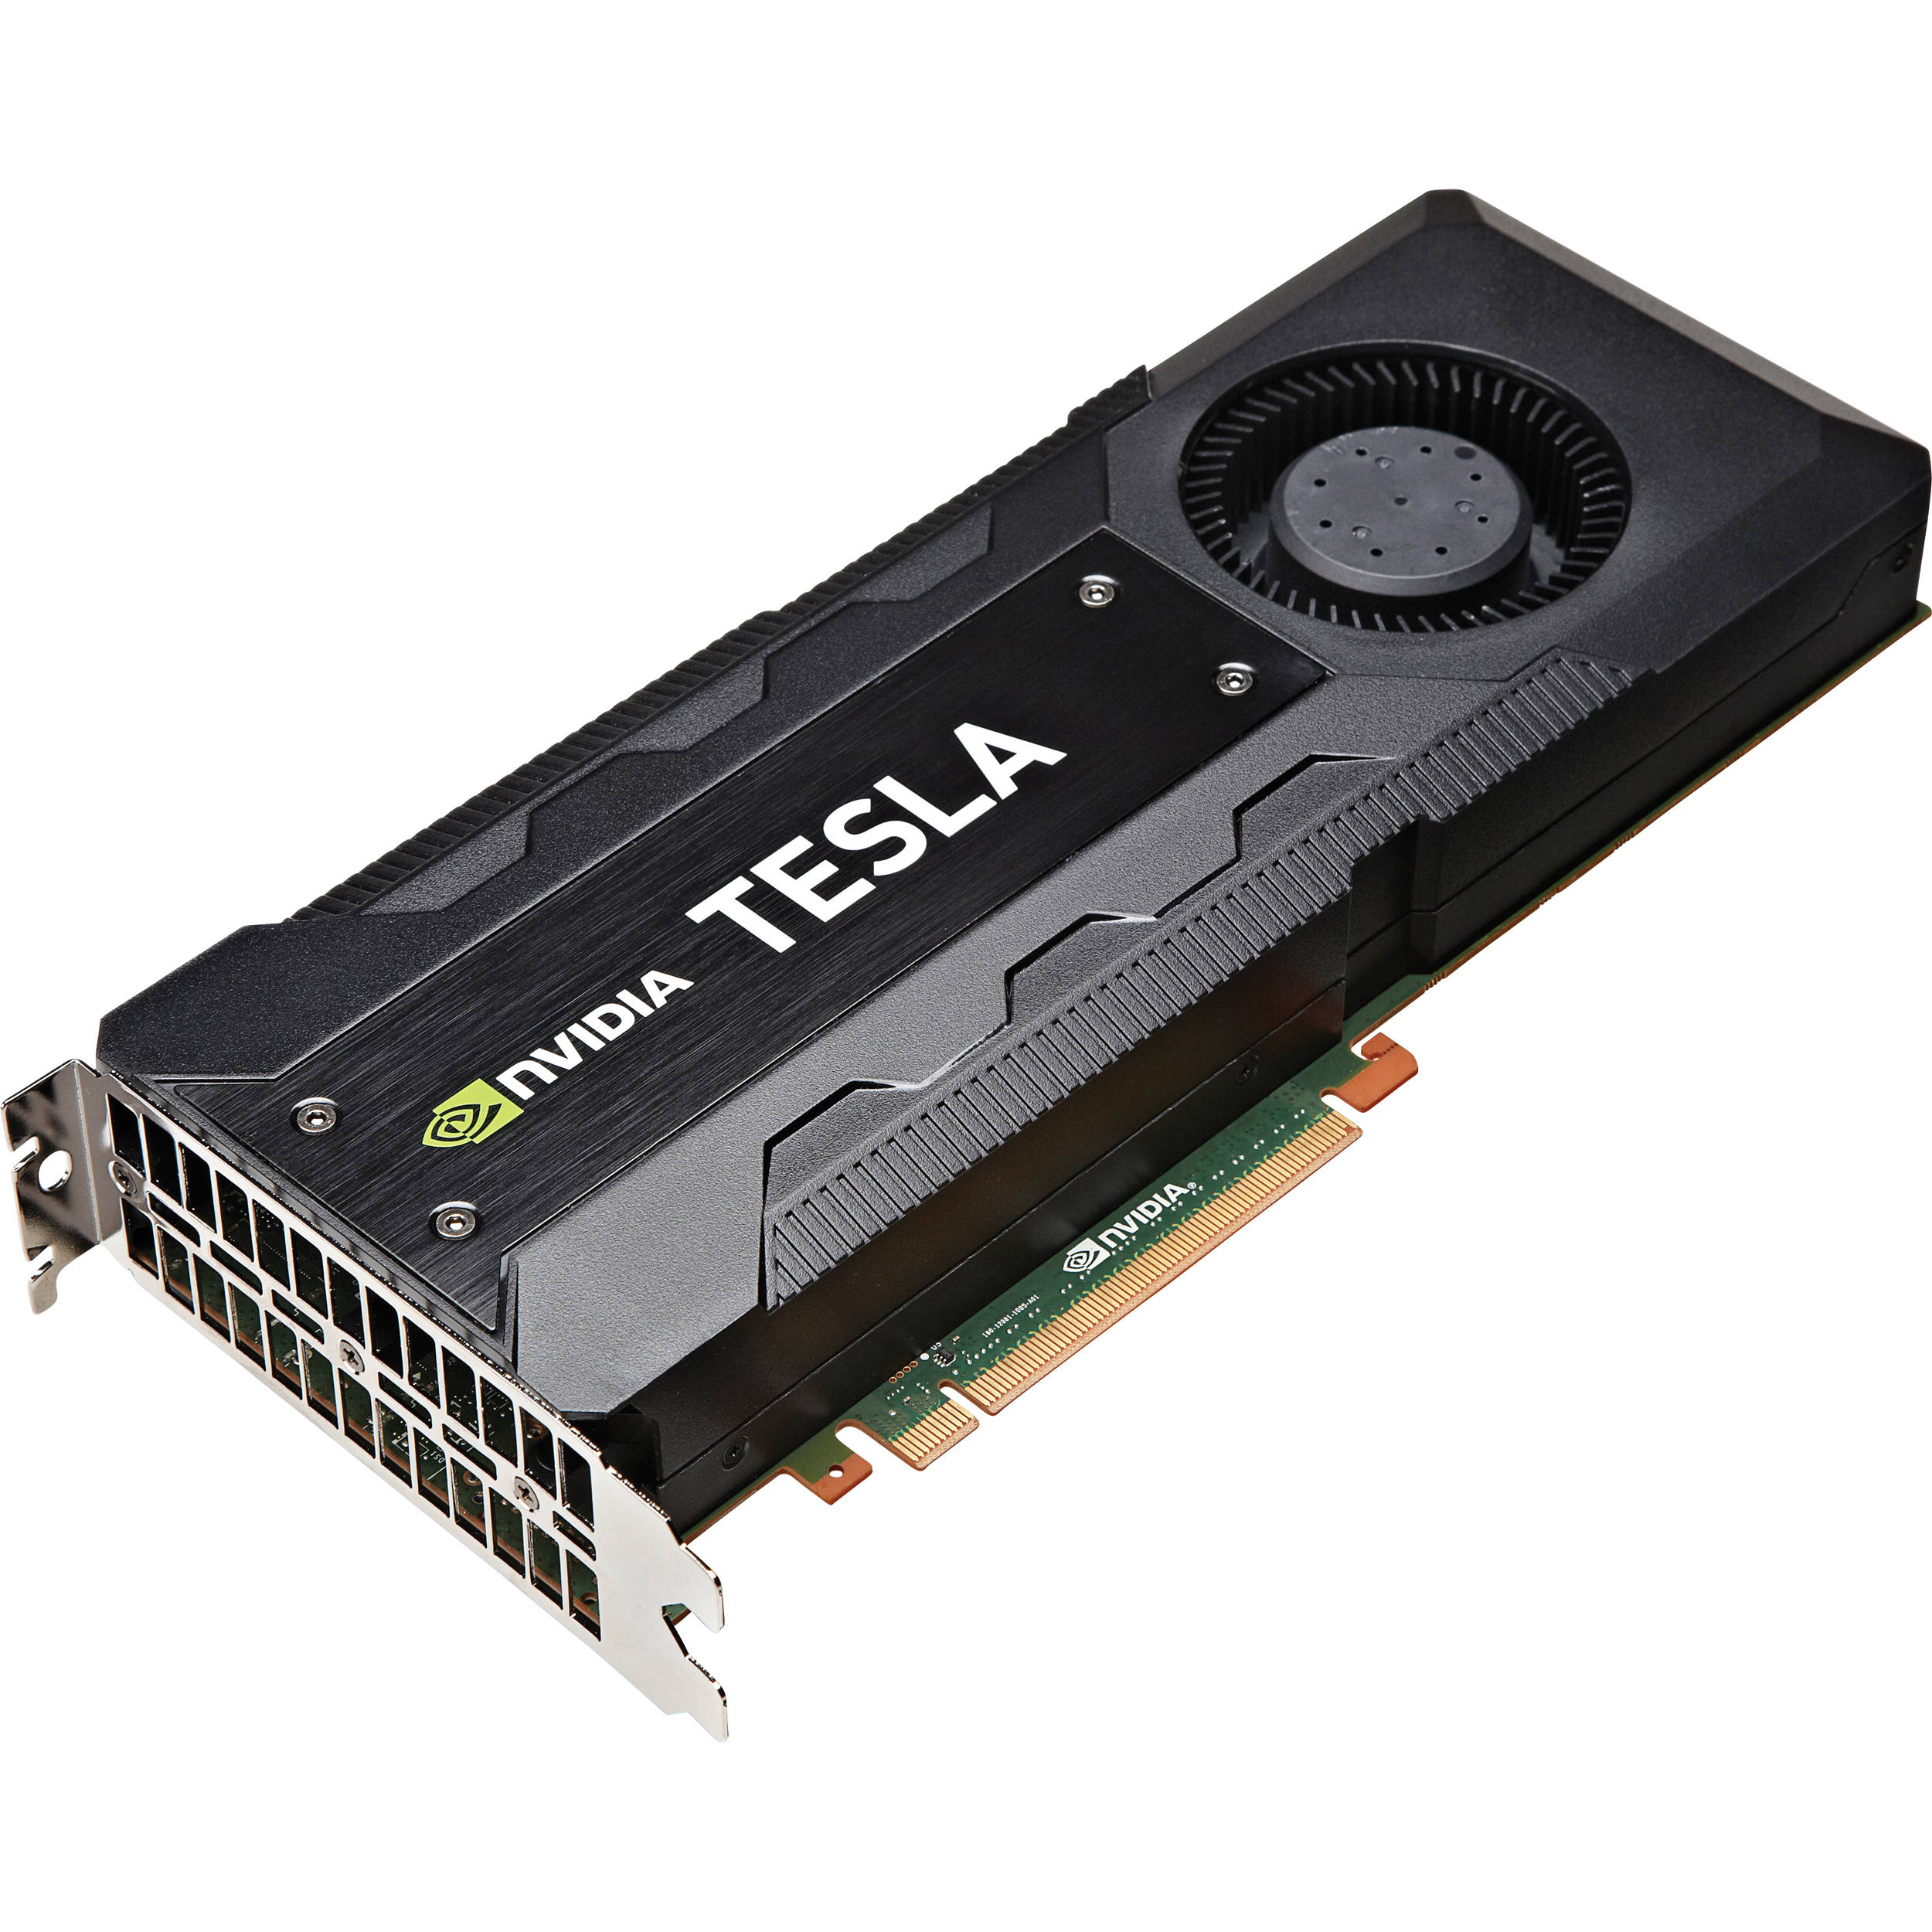
Scaling Compute Era
GPU is a programmable accelerator
that satisfy many application’s demands.
AI/Machine Learning
Data Analytics
Bioinformatics
8K Gaming/VR
HPC
Autonomous Vehicles / IoT
Notes:
There is no doubt we have witnessed the rise of new emerging scaling applications.
These applications exhibit high levels of implicit parallelism, which enables performance scalability, but only if compute resources can continue to scale.
GPU, in particular, is a programmable Accerlator that satisfy many application’s demands and has been used to accelerate these emerging workloads.

Slide 3
GPU Performance Scalability
Volta GPU
21B Tr @12nm
We need more!
DL, VR, 8K gaming,
Exascale computing, ...
Transparent Scaling
Pascal GPU
15B Tr @16nm
Normalized Performance
Maxwell GPU
8B Tr @28nm
Number of SMs
Scaling all the GPU resources: Increasing SMs, memory bandwidth and interconnection bandwidth.
Notes:
In this figure, we show the anticipated performance over scalable workloads if balanced GPU resources continue to scale, including the number of Streaming Multiprocessors and memory bandwidth.
Over the last decade and powered by the process technology advances, GPUs have successfully increased the number of SMs and transparently improving the performance by an order of magnitude.
However, as we can see in the figure, these workloads still contain further parallelism to exploit and need more compute resources than what is available today to continue performance scaling.

Slide 4
Manufacturing Hurdles
https://www.techpowerup.com/270097/samsungs-5-nm-euv-node-struggles-with-yields
https://www.eenewsanalog.com/news/intel-goes-foundry-7nm-due-yield-issues
Notes:
However, building a GPU with hundreds of SMs in a single monolithic GPU die will not be possible due to manufacturing hurdles found in small technology nodes.
As we can read in the news, the largest three chip manufactures are struggling with yield at 5 and 7 nm process technologies.

Slide 5
GPU Performance Scalability is at Risk!
??
@7-3nm
Low Yield
Very Expensive
Transparent Scaling
Volta GPU
21B Tr @12nm
Pascal GPU
15B Tr @16nm
Normalized Performance
Maxwell GPU
8B Tr @28nm
Number of SMs
Scaling all the GPU resources: Increasing SMs, memory bandwidth and interconnection bandwidth.
Notes:
This makes the GPU performance scalability at risk.
As the next GPU generations will have low manufacture yield and will be very expensive to build at small technology nodes.

Slide 6
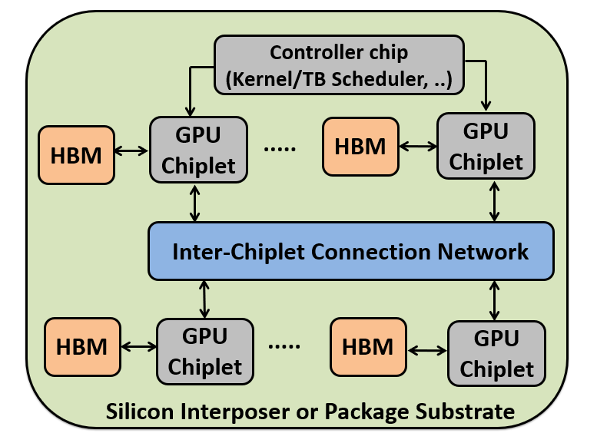
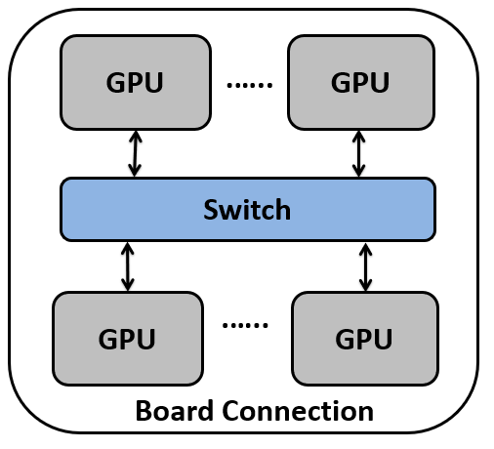
Hierarchical Multi-GPU Multi-Chiplet
Non-Uniform Memory Access (NUMA)
Single Logical GPU
Transparently overcoming these NUMA effects will be a challenging problem for GPUs over the next decade.
Notes:
To maintain performance scalability, proposals exist to aggregate discrete GPUs into a larger virtual GPU as well as decomposing a single GPU into multiple chiplets to increase aggregate die area.
To maintain the same programming model and improving development productivity, the multi-GPU and multi-Chiplet will be exposed as single logical GPU to the higher software levels.
These approaches introduce non-uniform memory access effects and lead to decreased performance and energy-efficiency if not managed appropriately
Transparently overcoming these NUMA effects will be a challenging problem for GPUs over the next decade.

Slide 7
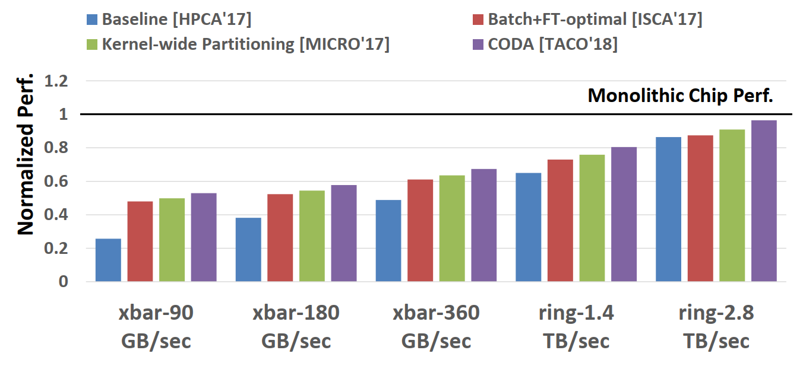
NUMA Impact
While CODA should be considered state-of-the-art, there still remains significant room for improvement.
Bandwidth sensitivity analysis of state-of-the-art techniques normalized to a hypothetical monolithic GPU with the same number of SMs.
Ideally, we would like to achieve the same monolithic chip performance with the cheapest possible interconnection.
Notes:
In this figure, we study the NUMA impact on a four GPU NUMA system when varying inter-GPU link bandwidth and topology. We evaluate state-of-the-art NUMA-GPU techniques normalized to a hypothetical monolithic GPU performance that has the same number of SMs.
Baseline applies roundrobin scheduling and placement, the technique Batch+FT applies batch scheduling and first touch page placement policies, kernel-wide partitioning partitions whole grid and data in large chunks, whereas the CODA is a static analysis-based multi-GPU scheduling.
To reduce the NUMA impact, we need to build almost 3 TB/s per GPU link which is very expensive and hard to manufacture.
Ideally, we would like to achieve the same monolithic chip performance and remove NUMA effects with the cheapest possible interconnection.
We observe that , the previous work, CODA, outperforms other techniques and should be considered state-of-the-art versus other policies, however, there still remains significant room for improvement in the cost-effective and limited-bandwidth connections.

Slide 8
State-of-the-art NUMA-GPUs
High Overhead
First Touch page faulting
Batch+FT [ISCA’17]
Limited Coverage
Do not exploit common locality patterns
Kernel-wide [MICRO’17]
CODA [TACO’18]
Non-transparent
Hand-tuned APIs
Locality Descriptor [ISCA’18]
Notes:
We qualitatively study state-of-the-art NUMA-GPU techniques, highlighting their deficiencies. The previous techniques are either relying on first-touch page placement policy that can introduces a substantial performance penalty.
Also, they may have limited coverage and do not exploit many common locality patterns found in GPU workloads. They work well for some locality patterns but not for others.
Third, they are not transparent and propose new APIs to the programmer.

Slide 9
Locality Aware Data Management (LADM)
Low Overhead
Be Proactive
Higher Coverage
Exploits GPU programming model patterns
Transparent
Same API Interface
LADM exploits a proactive Compiler-assisted Index Analysis to optimize threadblock scheduling, data placement and cache policy.
Notes:
To this end, we propose LADM, a locality-aware data management for Multi-GPU systems that address the previous work inefficiency. LADM has low overhead, it exploits GPU programming model patterns and transparent.
LADM achieves this by exploiting a proactive static index analysis to optimize theadblock scheduling, data placement and cache policy.

Slide 10
Agenda
Background and Motivation
LADM Overview.
Experimental Setup.
Experimental Results.
Conclusion.
Notes:
Now, we will show an overview of our LADM system

Slide 11
LADM Overview
Compiler
Runtime
Hardware
Source CUDA file
executable
void main() {
mallocMan(A);
mallocMan(B);
klaunch(B, A);
}
Compiler
kernel launch command
Driver
Node 0
Index
Analysis
Locality
Table
(BDim, GDim)
LASP
Node 1
…..
Node N
Runtime
Configuration
Locality-Aware Scheduling and Placement (LASP)
Static Index Analysis
Notes:
The figure shows an end-to-end overview of our proposed LADM mechanism.
First, we perform a symbolic off-line index analysis on CUDA source code during the compilation process.
Our analysis generates a locality table, which is embedded in the executable. The locality table contains the locality type for each global data access in the kernel.
Then, during run-time and on every kernel launch, the Locality-Aware Scheduling and Placement component found in the driver, reads the locality table, along with runtime configuration and grid dimensions.
Then, the LASP decides the proper scheduling policy, data placement and cache strategy to reduce off-chip traffic.

Slide 12
LADM Overview
Compiler
Runtime
Hardware
Source CUDA file
executable
void main() {
mallocMan(A);
mallocMan(B);
klaunch(B, A);
}
Compiler
kernel launch command
Driver
Node 0
Index
Analysis
Locality
Table
(BDim, GDim)
LASP
Node 1
…..
Node N
Runtime
Configuration
Static Index Analysis
Notes:
Now, we will discuss each component in details, and we start with our static index analysis.

Slide 13
Hierarchical GPU Programming Model
blockDim.x
gridDim.x
T1 | T2
T3 | T4
blockDim.y
TB1 | TB2 | TB3 | TB4
TB5 | TB6 | TB7 | TB8
TB9 | TB10 | TB11 | TB12
TB13 | TB14 | TB15 | TB16
CPU Thread 1
CPU Thread 2
CPU Thread 3
CPU Thread 4
gridDim.y
(tid.x, tid.y)
(bid.x, bid.y)
GPU hierarchical fine-grain threads
CPU flat coarse-grain threads
+ Scheduling at thread-block level
+ Expressive Thread IDs
+ Low work/spatial locality per thread
Notes:
The GPU programming model introduces new challenges in the design space for NUMA systems
The GPU employs hierarchal threading, in which the thread grid is composed a multi-dimensional grid of threadblock and each threadblock itself is composed of multi-dimensional fine-grained threads.
The CUDA programming model forces the programmer to use the hierarchal thread IDs explicitly to express the parallelism in the program.
This is different from the flat coarse-grain nature of CPU threads, where we have fewer coarse-grained threads do much more work than GPU threads.
In NUMA-GPU system, threads are assigned to GPUs at the threadblock granularity, not at the thread level.
This, combined with the expressiveness of thread IDs in GPU program, an inter-threadblock analysis must be performed, to account for both the hierarchy of the grid and the dimensionality of the thread grid.

Slide 14
Threadblock-Centric Index Analysis
DB0 | DB1 | DB2 | DB3
TB0 | TB1
Data Blocks
Threadblock Grid
for(int m = 0; m < N; ++m) {
/*Original Code:*/
BlackScholesBodyGPU ( d_CallResult[ tid + m * THREAD_N ] );
// Prime comp.
// BlackScholesBodyGPU( d_CallResult[
( bx * blockDim.x + tx ) + m * blockDim.x * gridDim.x ];
}
loop-invariant(bx,…)
loopvariant() = m*stride
BlackScholes_kernel Example
Notes:
So, we propose threadblock-centric index analysis, in this analysis, we create a 1:1 mapping between data and threadblock, we define the term datablock as the region of data accessed by a threadblock in each iteration of the kernel’s loop. datablocks are shaded based on the shade of the threadblock that accesses them, for example, threadblock 0 accesses datablocks 0 and 2
The arrow here indicates threadblock motion accesses over the datablocks.
Our index analysis idea is to breakdown index terms into prime terms, like thread Ids, constant values and loop variables
and then we divide these prime components into loop-variant group that contains all the terms dependent on an induction variable, and loop-invariant group that contains all the remaining terms. The loop invariant group tells us the start position of the threadblocks, in this example, it contains block Idx which indicates all the threadblocks will start from a unique position. Whereas, loop-variant group tells us the threadblock motion over datablocks. We used some heuristics, like the position of threadblock Ids, to identify the common locality patterns.

Slide 15
GPU Locality Patterns
No-datablock Locality (NL)
Row/Column Locality (RCL)
Intra-Thread Locality (ITL)
DB0 | DB1 | DB2 | DB3
TB0 | TB1
Row Horizontally
Shared
Single
Threadblock
DB (0,0) | DB (0,1)
TB (0,0) | TB (0,1)
Data Blocks
Threadblock Grid
Row Vertically
Shared
DB0
T0
T1
..
Tn
Stride in X-direction
Row-Locality
Horizonal-Sharing
DB1
DB (0,0)
DB (1,0)
Column Horizontally
Shared
TB (0,0)
TB (1,0)
…
griddim.x*blockdim.x
DBn
DB0 | DB1
DB2 | DB3
DB3 | DB4
DB5 | DB6
TB0 | TB1
TB2 | TB3
Column Vertically
Shared
Regular ITL accesses
Column-Locality
Vertical-Sharing
DB0
T0
T1
..
Tn
Data Blocks Accessed
TB sharing datablocks
DB1
…
loopInvariant (by,...) + loopVariant (m,...)
DBn
Stride in Y-direction
loopInvariant (bx,...) + loopVariant (m,...)
Random ITL accesses
loopInvariant (by,...) + loopVariant (m,gDimx,,...)
1D - loopInvariant (bx,...) + stride*m
2D - loopInvariant (bx,by,...) + stride*m
loopInvariant (bx,...) + loopVariant (m,gDimx,,...)
loopVariant(m) = m
Notes:
Based this index analysis, we classify the locality pattern into one of following categories: First, No datablock-locality.
In this pattern, threadblocks access exclusive datablocks with a stride in either the x or y direction as shown in the figure.
The second locality pattern is Row and Column locality, in which datablocks are accessed in either the row or column directions,
and they are accessed by either a row or a column of threadblocks from 2-dimentional thread grid.
Making all the 2 by 2 combination gives us four different sharing patterns.
The last type is Intra-Thread Locality, in which individual threads within a single threadblock exhibit intra-thread spatial locality across regular or random accesses. Finally, if the array index does not match one of these locality types, we leave it as unclassified and the default placement policy is used.
It is important to note that, Because we do not do any data or code transformation, If our analysis does not perfectly match this pattern, it won’t affect program functionality and it will just generate more off-chip traffic.

Slide 16
LADM Overview
Compiler
Runtime
Hardware
Source CUDA file
executable
void main() {
mallocMan(A);
mallocMan(B);
klaunch(B, A);
}
Compiler
kernel launch command
Driver
Node 0
Index
Analysis
Locality
Table
(BDim, GDim)
LASP
Node 1
Node N
Runtime
Configuration
Locality-Aware Scheduling and Placement (LASP)
Notes:
The second piece is the runtime component, LASP

Slide 17
LASP for No-datablock Locality
Alignment–aware Scheduler
Stride-aware Placement
Schedule the TBs in large batches where min batch size is
Kernel-wide partitioning
Node 0
Node 1
GPU Node
Page size
gridDim.x * blockDim.x
Data
Blocks
DB0
DB1
DB2
DB3
Physical Memory Page
data_size
TB 1
……..
TB
Grid
TB 0
TB N
TB 1
Blockdim.x
Blockdim.x
blockDim.x
$$\text{MinTBBatch}\text{ (}\text{N}\text{)}=\frac{\text{Pagesize}}{\text{datablockSize}}$$
Varies per
Kernel
Milic et al., “Beyond the Socket: NUMA-Aware GPUs”, MICRO’17
Notes:
A stated earlier, LASP decides the proper scheduling policy and data placement to reduce off-chip traffic.
For no locality workload, the LASP schedules threadblocks in a large batch size to ensure page alignment.
dividing the page size by the datablock size tells us the minimum number of consecutive threadblocks that should be assigned to each node to avoid misaligning. Based on that, the batch size varies per kernel, as each kernel will have different datablock size.
For data, we use stride-aware placement. The previous work, kernel-wide partitioning, partitions data among the chips without considering stride information, resulting in significant off-chip accesses.

Slide 18
LASP for No-datablock Locality
Alignment–aware Scheduler
Stride-aware Placement
Schedule the TBs in large batches where min batch size is
Our approach: stride-aware
Node 0
Node 1
GPU Node
Page size
gridDim.x * blockDim.x
Data
Blocks
DB0
DB2
DB1
DB3
Physical Memory Page
data_size
TB 1
……..
TB
Grid
TB 0
TB N
TB 1
Blockdim.x
Blockdim.x
blockDim.x
$$\text{MinTBBatch}\text{ (}\text{N}\text{)}=\frac{\text{Pagesize}}{\text{datablockSize}}$$
Varies per
Kernel
Notes:
In our approach, we use stride information provided by the compiler analysis to determine which pages need to be co-located on a given node, eliminating off-chip traffic.

Slide 19
LASP for Row/Column Locality
Binding consecutive rows/columns of threadblocks and datablocks to one Node.
Node 0
TB1 | TB2 | TB3 | TB4
TB5 | TB6 | TB7 | TB8
SM
SM
Row 1
Row 2
HBM
Row 1
Row 2
Row 3
Row 4
TB1 | TB2 | TB3 | TB4
TB5 | TB6 | TB7 | TB8
TB9 | TB10 | TB11 | TB12
TB13 | TB14 | TB15 | TB16
Node 1
TB9 | TB10 | TB11 | TB12
TB13 | TB14 | TB15 | TB16
SM
SM
Data Blocks
Compute TB Grid
Row 3
Row 4
HBM
Row Locality
Notes:
In case of row locality, the same row in the threablock grid accesses the data elements in the same row of the data blocks.
In this case, we bind consecutive rows of threadblocks and datablocks to one Node such that row-level datablock-locality is exploited.
Similarly, for column locality, we bind consecutive columns of threadblocks and data blocks to one Node.

Slide 20
Data structure Locality Disagreements
Applications that have both row and column locality.
Matrix Multiplication Example:
Matrix B
DB0 | DB1
DB2 | DB3
Col Placement
Col Scheduler
Matrix A
Row Placement
DB0 | DB1
DB2 | DB3
TB0 | TB1
TB2 | TB3
Row Scheduler
Collision. We must pick a winner.
Tie Breaker: we favor the scheduling policy that is associated with larger data structure that has higher compulsory misses.
Compute TB Grid
Notes:
Some kernels will access multiple data structures in different ways. When this happens, each structure will be placed in the correct way, but there is only one threadblock scheduler we can select for a particular kernel.
For example, in matrix multiplication, the placement of the matrix A favors a row scheduler, whereas the placement of matrix B favors column scheduling
And, so, in this case, we have a collision and we have to pick a winner,
To break the tie, we favor the scheduling policy that is associated with the larger data structure, because it will intuitively have more compulsory misses and thus, a bigger effect on off-chip accesses, whereas smaller, frequently accessed data structures have a greater chance of hitting in the local L2 cache. So, in our example, if matrix A is greater than B, we choose a row scheduling

Slide 21
LASP for Intra-Thread Locality
Regular access with ITL
Random Access with ITL
DB0
T0
T1
DB0
T0
T1
Node 0
TB0
Node 0
TB0
DB1
DB1
DB3
T0
T1
DB3
T0
T1
Node 1
TB1
Node 1
TB1
DB4
DB4
Apply coarse-grain data and kernel partitioning to preserve data locality per thread
+ Optimized cache policy
Notes:
For intra-thread locality, that is widely exist in data analytics and graph traversal workloads.
LASP applies coarse grain data and kernel partitioning to preserve data locality per thread.
So, in our example here, we partition both the kernel threadblocks and data into two large contiguous chunks over the two nodes.
For the workloads that have irregular random accesses and generate off-chip traffic as shown in the right example, we applied an optimized cache policy.

Slide 22
Compiler-Assisted Remote Request Bypassing (CRB)
Home Node
Remote Node
Home Node
Remote Node
SM
SM
SM
SM
SM
SM
SM
SM
SM
SM
SM
SM
L2$
L2$
L2$
L2$
HBM
HBM
Cache-remote-twice (RTWICE) for RCL workloads
Cache-remote-once (RONCE) for ITL workloads.
Notes:
Our optimized cache policy is named compiler-assisted remote request bypassing. In our baseline and similar to the previous work, the L2 cache is shared between local and remote traffic.
In this scenario, remote requests are cached twice, once at the L2 cache of the home GPU and another time at the L2 cache of the remote GPU that sent the request.
In fact, cache-remote-twice policy can be beneficial in RCL workloads where remote requests are accessed by multiple SMs across the GPUs.
However, workloads with intra-thread locality, caching requests twice is a waste of cache resources as the cache line is only accessed by one SM in the requesting GPU. So, in this case, we cache-remote-request once at the remote node.
We use our compiler index analysis to determine the locality type found in the program and apply the right policy.

Slide 23
Agenda
Background and Motivation
LADM Overview.
Experimental Setup.
Experimental Results.
Conclusion.
Notes:
In the next slides we show our experimental setup.

Slide 24
Experimental Setup
GPGPU-sim 4.x + Accel-Sim simulation framework.
Why Simulation?
L2 remote caching, inter-GPU cache coherence, access to the driver and hierarchical cluster are not present in GPUs that are available to researchers today.
Multi-GPU Simulation Configuration:
720 GB/s per-GPU
(bi-directional)
GPU
GPU
180 GB/s
16 SMs
HBM
GPU
Chiplet
GPU
Chiplet
HBM
Switch (180 GB/s per link)
GPU
GPU
GPU
Chiplet
HBM
GPU
Chiplet
HBM
Package Substrate
M. Khairy, “Accel-Sim: An Extensible Simulation Framework for Validated GPU Modeling”, ISCA 2020
Notes:
To evaluate LADM we use GPGPU-Sim version 4.0 with the recent memory system improvements from Accel-Sim simulation framework.
The reason we used simulation is because the L2 remote-caching and inter-GPU cache coherence among others are not present in the GPUs available to researchers today, so we evaluate our experiments in simulation. We also provide some results on real hardware of NVIDIA DGX server. These results can be found in the paper.
Our Multi-GPU simulation system is configured to contain four GPUs connected via switch.
Each GPU is composed of four chiplets.
Each chiplet has 16 SMs and one HBM stack, and the chiplets are connected via a ring topology.

Slide 25
Workloads Characterization
53 workloads from Rodinia, Parpoil, CUDA SDK, Pannotia and Machine learning GeMM.
27 workloads
Normalized Performance
26 workloads
Number of SMs
Notes:
We run LADM on a selection of 53 workloads from different benchmarks suites. Like prior work, we pare the 53 workloads from all the benchmarks suites and select only 27 scalable workloads that have enough parallelism to scale-up on our simulated multi-GPU system

Slide 26
Agenda
Background and Motivation
LADM Overview.
Experimental Setup.
Experimental Results.
Conclusion.
Notes:
Then we discuss our experimental results.

Slide 27
Experimental Results
NL
RCL
ITL
Unclassified
Normalized Perf.
Off-chip Traffic (%)
Notes:
In the top figure, we show the performance of CODA, LADM that combines LASP with CRB. The results are normalized to the hypothetical monolithic chip performance.
In the bottom figure, we show the off-chip traffic percentage.
For no-locality workloads, the LASP’s stride-aware placement reducing off-chip traffic significantly compared to CODA. These off-chip reduction is translated to 3x performance improvement on average.
In RCL workloads, preserving row and column-locality along with input size awareness, makes LADM outperforms CODA that applies fine-grained round-robin page interleaving that destroys row and column-locality.
In ITL, LADM coarse-grain partitioning to preserve CSR graph locality along with cache-remote-once improves the performance by 2x
Finally, in unclassisifed locality, LADM’s kernel-wide partition placement still improves the performance for some workloads.
Overall, LADM outperforms CODA by 1.8× on average and capturing 82% of monolithic chip performance. The reasons behind the remaining gap between LADM and monolithic chip are complex indices that LADM fails to analyze and irregular data-dependent accesses.

Slide 28
CRB Analysis
NL
RCL
ITL
Unclassified
Normalized Perf.
Notes:
To understand the efficacy of our compiler-assited cache bypassing, we evaluated the performance effect of cache-remote-twice and cache-remote-once.
cache-remote-once improves the performance of intra-thread-locality workloads by 40% on average,
whereas it hurts the performance by 8% for the row and column locality workloads and stencil applications.
So, In our compiler-assited cache bypassing, it takes the best of both policies by enabling remote-once policy in intra-thread-locality and remote-twice policy in other locality patterns

Slide 29
Agenda
Background and Motivation
LADM Overview.
Experimental Setup.
Experimental Results.
Conclusions.
Notes:
Finally, in conclusion

Slide 30
Conclusions
Problem Definition:
Due to the physical limitations of chip and interconnect technologies, GPUs will have to overcome significant NUMA effects.
Solution:
We propose a locality-aware data management system designed to transparently overcome the NUMA effects of future hierarchical GPUs.
Key Results:
LADM decreases inter-GPU memory traffic by 4x, improving system performance by 1.8x across a range of workloads with varying locality.
Future Directions :
Further customization to advance static analysis for strong NUMA-GPU scaling.
Notes:
Due to the physical limitations of chip and interconnect technologies, GPUs will have to overcome significant NUMA effects.
We propose a locality-aware data management system designed to transparently overcome the NUMA effects of future hierarchical GPUs.
LADM decreases inter-GPU memory traffic by 4X improving system performance by 1.8x
As future directions, we believe that static analysis is the right direction to build cost-effective multi-GPU interconnects, however, we believe there are still more opportunities to further customization to advance static analysis for strong NUMA-GPU scaling

Slide 31
Thanks!
This presentation and recording belong to the authors.
No distribution is allowed without the authors' permission
Mahmoud Khairy abdallm@purdue.edu
Notes:
Thanks for watching our presentation
And stay safe

Slide 32
Backup slides

Slide 33
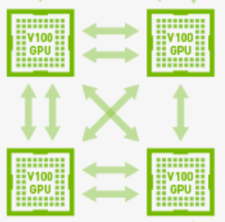
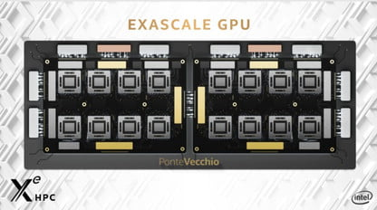
NUMA-GPU is already out there!
Nvidia DGX server
(4-16 GPUs)
Nvidia Ampere has two virtual chiplets (on the same silicon) under the hood
Next Intel Xe GPU
8 chiplets per GPU
6 GPUs per server

Slide 34
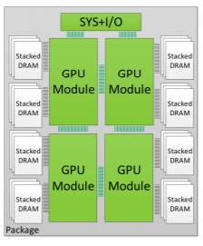
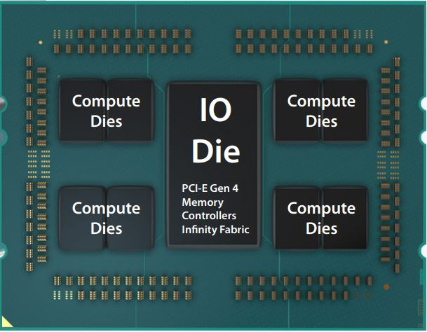
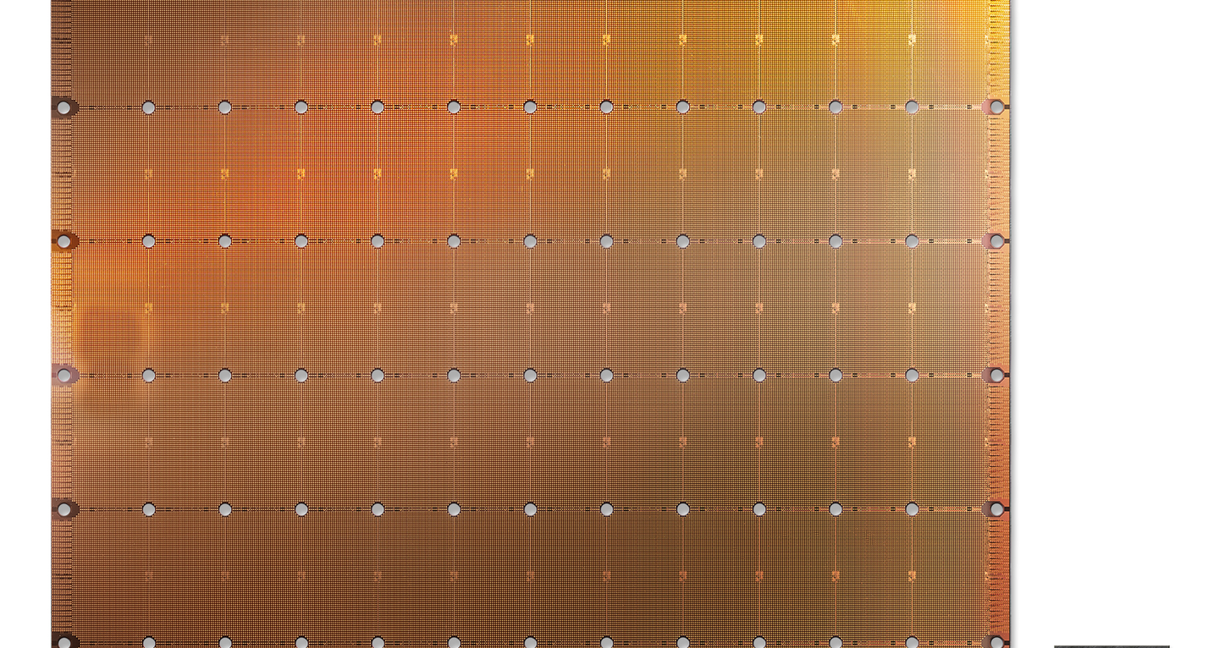
Interconnect Technologies
PCB Connection
(e.g. NVLink)
Nvidia’s GRS
Package Substrate
AMD’s
Interposer TSVs
Intel’s EMIB (Foveros)
Wafer-scale (UCLA’s Si-IF)

Slide 35
Solution#1: Chiplet-based GPU
Easy manufacturable, high yield and less expensive Chiplets.
Single Logical GPU
Non-Uniform Memory Access
(NUMA)
GPU
Arunkumar et al, “MCM-GPU: Multi-Chip-Module GPUs for Continued Performance Scalability” ISCA 2017
Kannan et al ,“Enabling Interposer-based Disintegration of Multi-core Processors”, MICRO 2015
Notes:
To overcome these problems, researchers have proposed disaggregating large monolithic GPU chip into smaller, easy manufacturable and high yeild chiplets. The chiplets will be connected on silicon interposer or package substrate.
To maintain the same programming model and improving development productivity, the chiplets will be exposed as single logical GPU to the higher software levels.
However, the inter-chiplet connection may introduce non-uniform-memory-access penalty if bandwidth restricted interconnections are employed. Also, chiplet design will probably be limited by the size of silicon interposer.

Slide 36
Solution#2: Socket-based Multi-GPU
More scalable and cost-effective interconnects.
Single Logical GPU
Exacerbates NUMA effects
Milic et al., “Beyond the Socket: NUMA-Aware GPUs”, MICRO 2017
Notes:
Another solution proposed is socket-based multi-GPU, in which, aggregating multiple GPUs together as a single logical GPU.
Compared to chiplets, multiple GPUs are more easily combined into large and scalable systems.
However, the printed circuit board based connection can suffer from lower inter-GPU bandwidth, which exacerbates the NUMA performance penalty.

Slide 37
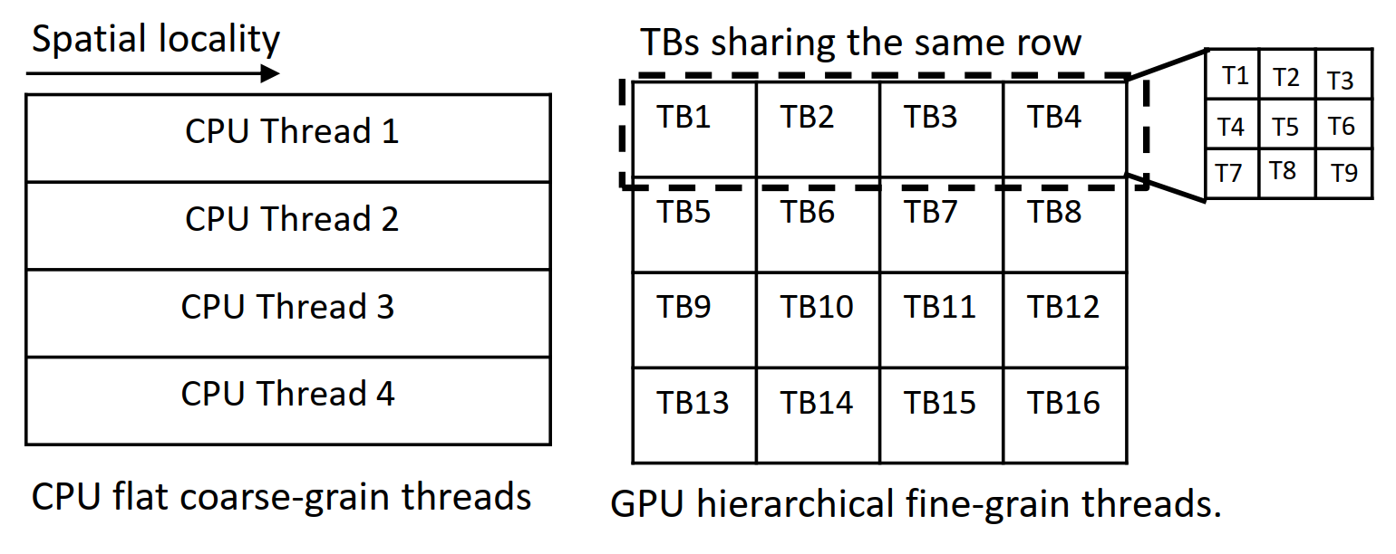
NUMA Locality in CPUs vs GPUs
Many NUMA-CPU proposals are reactive solutions.
R-NUMA, COMA, R-NUCA, Carrefour, ………
In GPUs, reactive systems can introduce a substantial performance penalty that can outweigh the benefits.
First-touch, page migration -> substantial performance penalty (20-50 us).
Data replication -> GPU memory capacity pressure is a scarce resource (16-32 GB).
Work redistribution -> Many number of threads and bandwidth-limited workloads.
CPU vs GPU Programming model.
Zheng et al, “Towards High Performance Paged Memory for GPUs ”, HPCA’16
Young et al., “Combining HW/SW Mechanisms to Improve NUMA Performance of Multi-GPU Systems”, MICRO’18

Slide 38
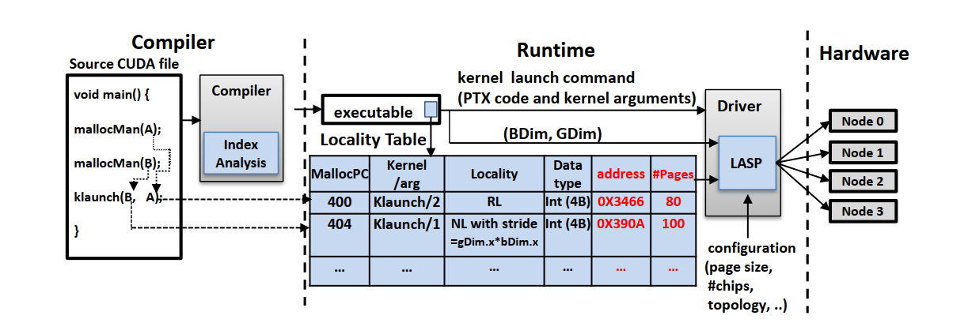
LADM Overview

Slide 39
Example: FC-1 Layer in VGG network
Unequal matrix sizes are commonly found in deep learning applications .
Optimize for compulsory/capacity misses.
4096
Weight matrix
(392 MB)
25088
Column Scheduler is preferred!
Large footprint
High compulsory
/capacity misses
Smaller footprint
Higher locality intensity (80% accesses),
but can be easily cached at L2 (cache resident)
25088
Batchsize
= 64
6 MB
TB | TB | … | … | … | … | … | …. | … | TB
TB | TB | … | … | … | … | … | … | ... | TB
Source: http://15418.courses.cs.cmu.edu/spring2017/lecture/dnn/slide_035

Slide 40
Dynamic Shared L2 Remote-Caching [MICRO’17]
Controller chip
(I/Os, Kernel/TB Scheduler, ..)
TB Scheduler
Streaming
Multiprocessor
Streaming
Multiprocessor
HBM
GPU
Chiplet
GPU
Chiplet
HBM
.…….…..
LOCAL
Intra-Chip Xbar
Remote
GPU
Chiplet
GPU
Chiplet
L2 $
..…..
L2 $
HBM
HBM
Inter-Chiplet Connection
Silicon Interposer or Package Substrate
HBM
HBM

Slide 41
Dynamic Shared L2 Remote-Caching [MICRO’17]
Controller chip
(I/Os, Kernel/TB Scheduler, ..)
TB Scheduler
Streaming
Multiprocessor
Streaming
Multiprocessor
HBM
GPU
Chiplet
GPU
Chiplet
HBM
.…….…..
LOCAL-
REMOTE
LOCAL-
LOCAL
REMOTE
-LOCAL
GPU
Chiplet
GPU
Chiplet
L2 $
..…..
L2 $
HBM
HBM
Inter-Chiplet Connection
Silicon Interposer or Package Substrate
HBM
HBM
LOCAL-REMOTE misses = REMOTE-LOCAL accesses = Off-chip accesses

Slide 42
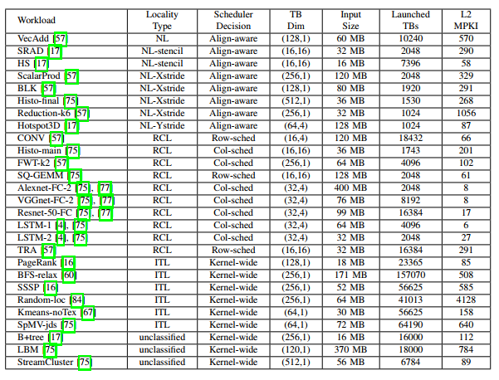
Workloads Characterization (cont.)

Slide 43
More Results in the Paper
CRB analysis
LASP on read DGX hardware.

Slide 44
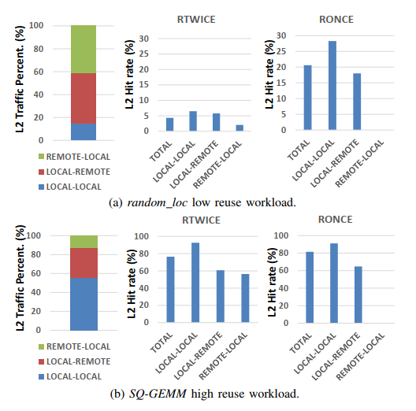
CRB analysis

Slide 45
Experimental Results
NL
RCL
ITL
Unclassified
Normalized Perf.
NL
RCL
ITL
Unclassified
Off-chip Traffic (%)
Notes:
In the top figure, we show the performance of CODA, LASP with RTWICE and RONCE policies and LADM that combines LASP with CRB. The results are normalized to the hypothetical monolithic chip performance.
In the bottom figure, we show the off-chip traffic percentage.
For no-locality workloads, the LASP’s stride-aware placement reducing off-chip traffic significantly compared to CODA. These off-chip reduction is translated to 3x performance improvement on average.
In RCL workloads, preserving row and column-locality along with input size awareness, makes LADM outperforms CODA that applies fine-grained round-robin page interleaving that destroys row and column-locality. In the machine-learning workloads, L2 remote-caching filters out off-chip traffic significantly with only 8% remaining.
In ITL, LADM coarse-grain partitioning to preserve CSR graph locality and cache-remote-once improves the performance by 2x
Finally, in unclassisifed locality, LADM does not improve either performance or off-chip data accesses, except for streamcluster
Overall, LADM outperforms CODA by 1.8× on average and capturing 82% of monolithic chip performance. The reasons behind the remaining 18% performance gap between LADM and monolithic chip are complex indices that LADM fails to analyze, irregular data-dependent accesses and the L2 cache coherence overhead.

Slide 46
Hierarchical GPU Programming model
blockDim.x
gridDim.x
T1 | T2
T3 | T4
blockDim.y
TB1 | TB2 | TB3 | TB4
TB5 | TB6 | TB7 | TB8
TB9 | TB10 | TB11 | TB12
TB13 | TB14 | TB15 | TB16
CPU Thread 1
CPU Thread 2
CPU Thread 3
CPU Thread 4
gridDim.y
(tid.x, tid.y)
(bid.x, bid.y)
GPU hierarchical fine-grain threads
Low work/spatial locality per thread
Expressive Thread IDs
Scheduling at thread-block level
CPU flat coarse-grain threads
High work/spatial locality per thread
Scheduling at thread level
Notes:
The GPU programming model introduces new challenges in the design space for NUMA systems
The GPU employs hierarchal threading, in which the thread grid is composed a multi-dimensional grid of threadblock and each threadblock itself is composed of multi-dimensional fine-grained threads.
The CUDA programming model forces the programmer to use the hierarchal thread IDs explicitly to express the parallelism in the program.
This is different from the flat coarse-grain nature of CPU threads, where we have fewer coarse-grained threads do much more work than GPU threads.
In NUMA-GPU system, threads are assigned to GPUs at the threadblock granularity, not at the thread level.
This, combined with the expressiveness of thread IDs in GPU program, an inter-threadblock analysis must be performed, to account for both the hierarchy of the grid and the dimensionality of the thread grid.

